Slide 1

Android App Development Session 8

Slide 2
Contents
Service
Service
IntentService
BoundService

Slide 3
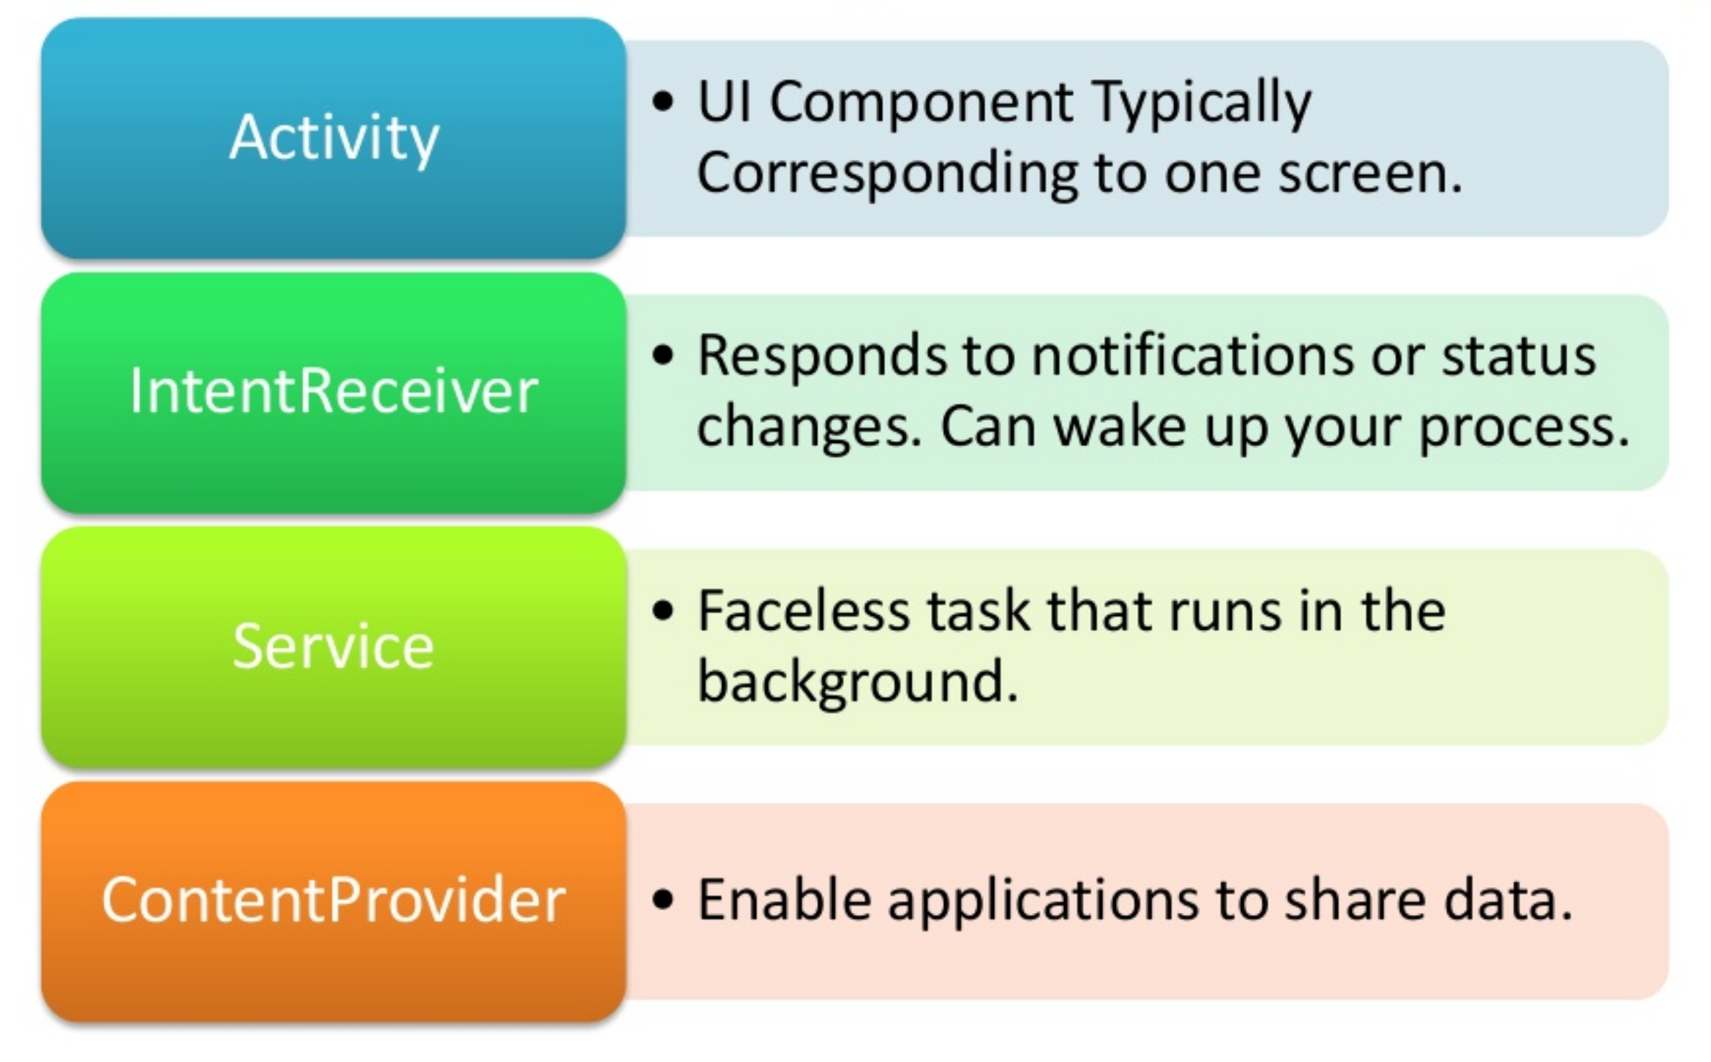
Android Building Blocks

Slide 4
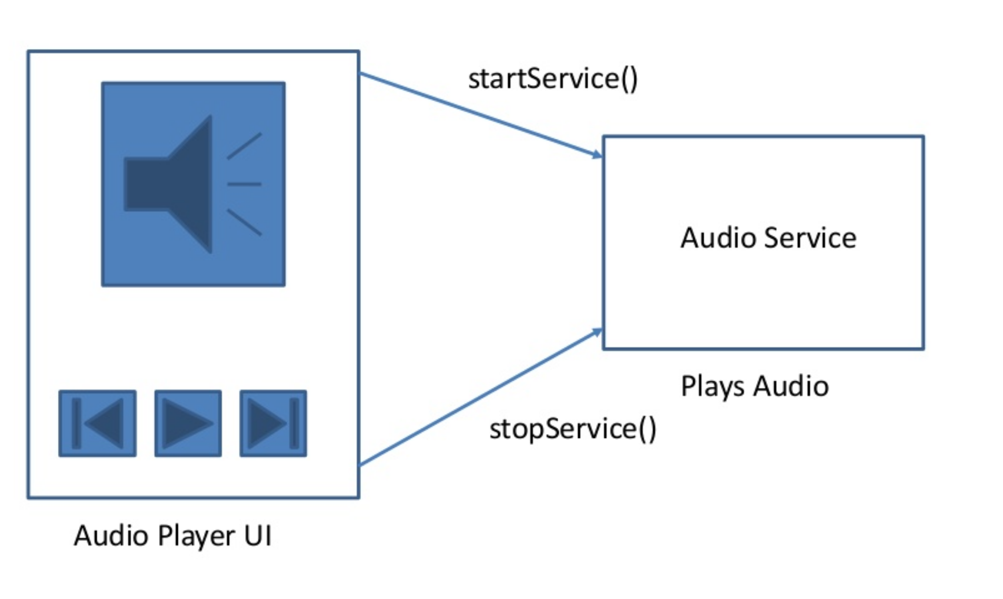
Service
One of the four major component
Used to perform long running task in background
Doesn’t have UI

Slide 5
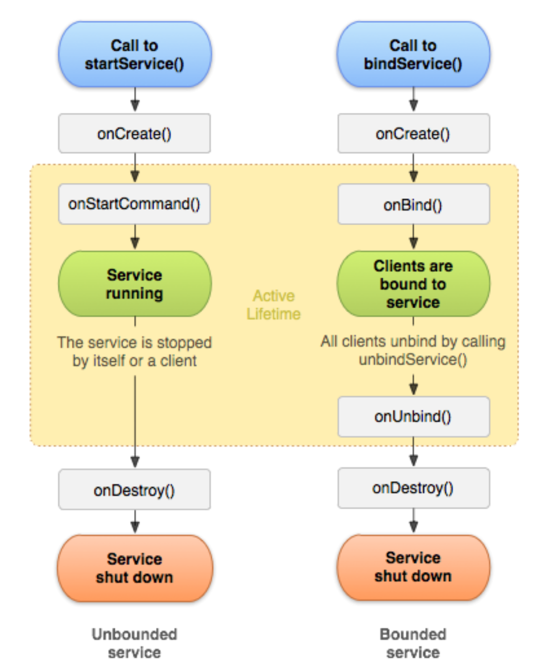
Service Lifecycle

Slide 6
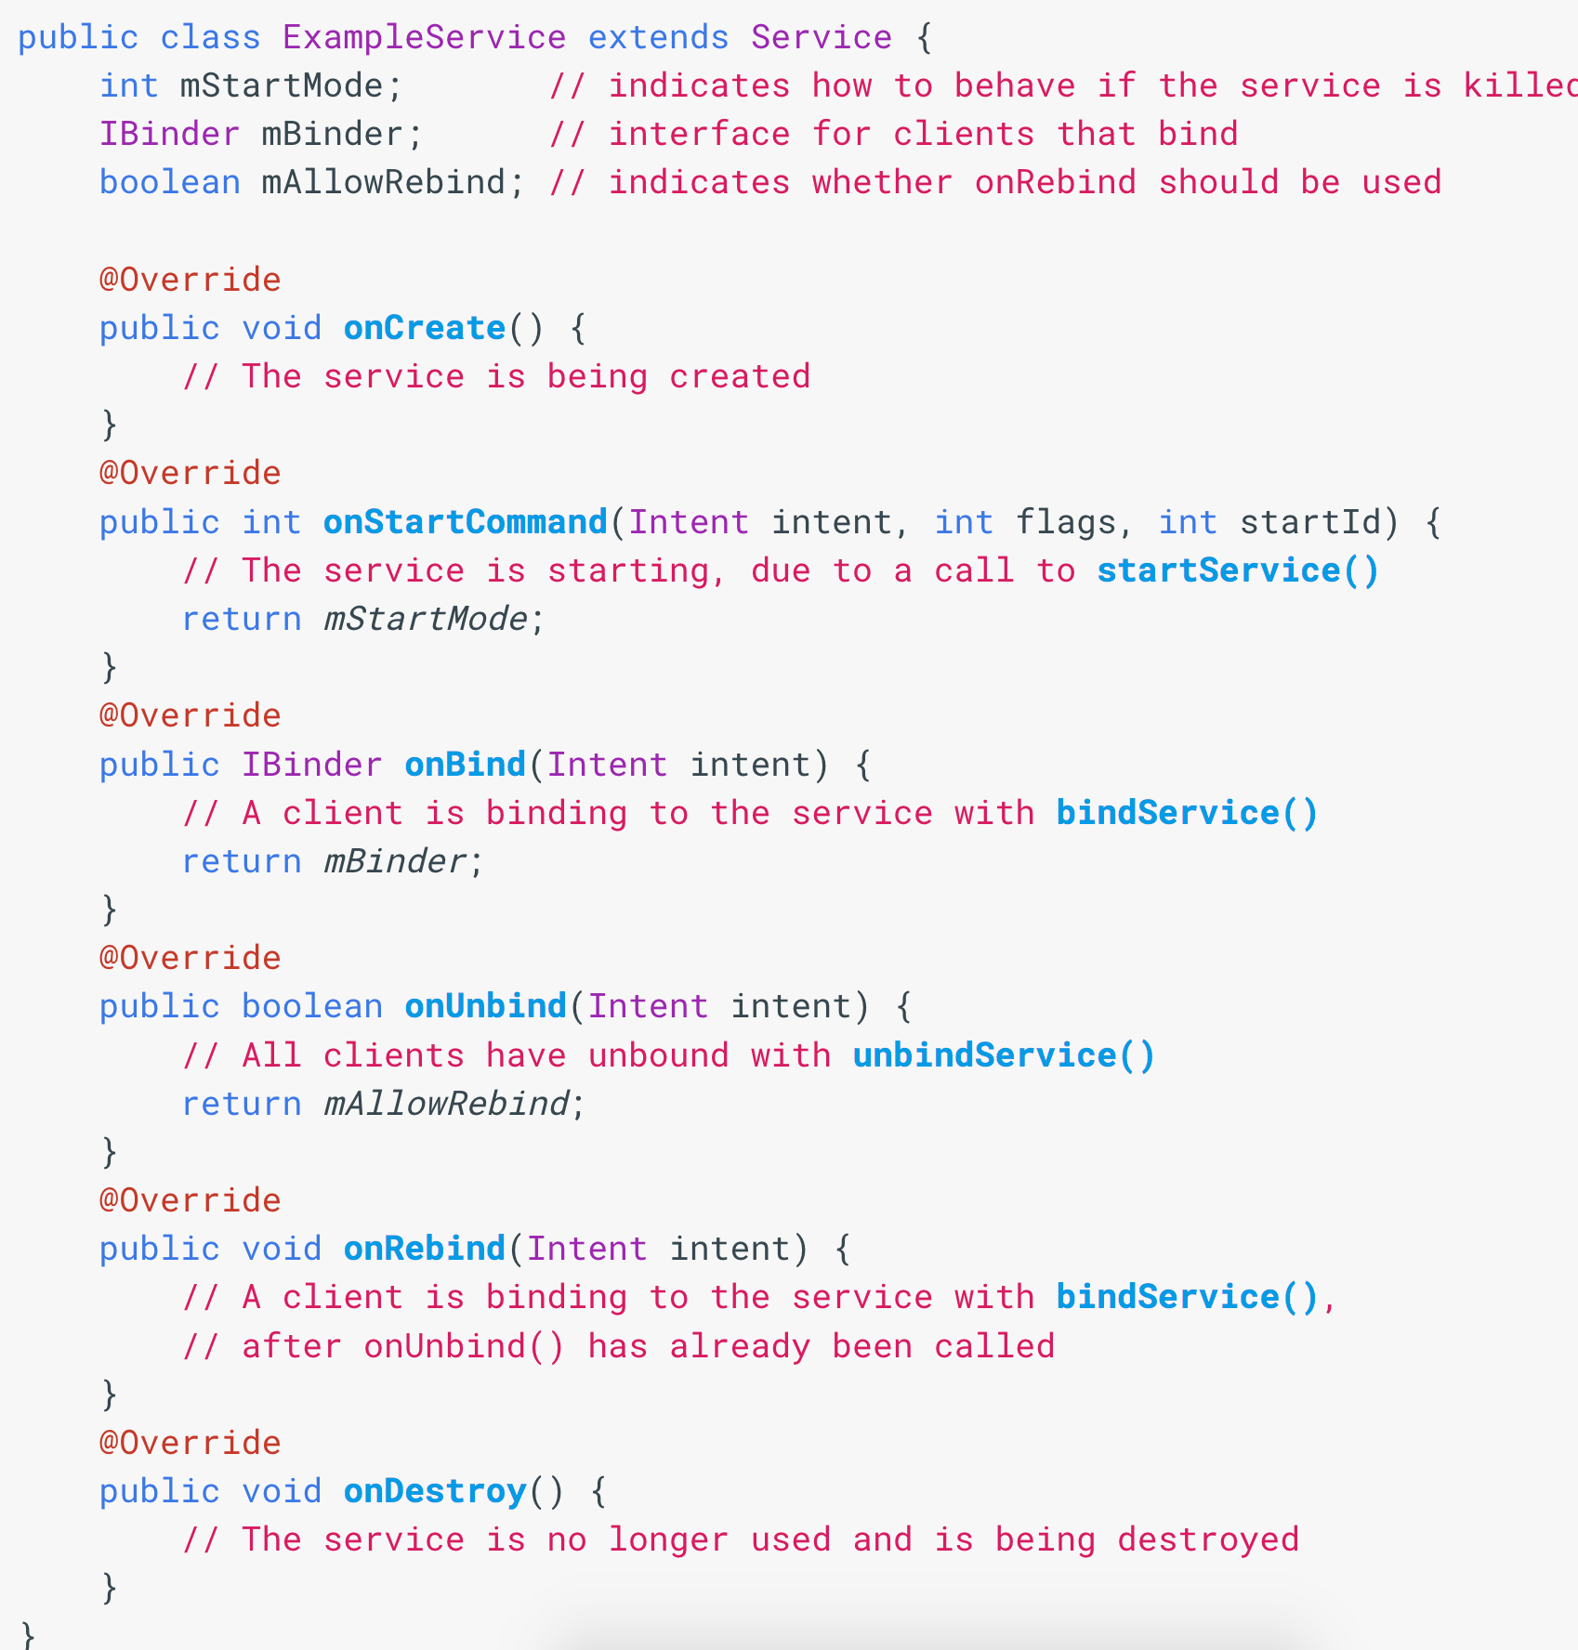
Creating a Service
One of the four major component
Used to perform long running task in background
Doesn’t have UI

Slide 7
Service
onStartCommand(): invoked when another component invokes StartService(). The instance of the service is unique, so each new call to StartService () does not create a new instance of the Service, but is rerun the onStartCommand(). It is not necessary to override it if you want to create a Bound Service.
onBind(): abstract method that must return a IBinder to retrieve the instance of the Service. If you do not want to create a BoundService this method must return null.
onCreate(): first creation callback method.
onDestroy(): last lifecycle method used to free resources.

Slide 8
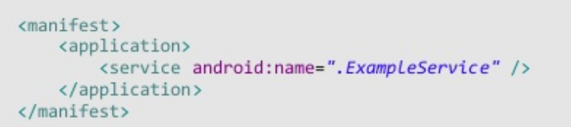
Using Service
Like all other main components, services should also be declared in the manifest file.

Slide 9
Using Service
A StartedService starts with the call to StartService ().
To close a StartedService call StopService() from the outside or Service.stopSelf () internally when the operation is finished.
There are 2 classes to create a Started Service:
Service:
it is the class that all the Services extend. You need to create a WorkerThread because all the service is performed in the Main Thread and this could block the GUI of any Activity in the foreground on the same process. It can handle multiple simultaneous requests.
IntentService:
specialization of Service that handles each request in a WorkerThread. It is the best choice to handle requests in series.

Slide 10
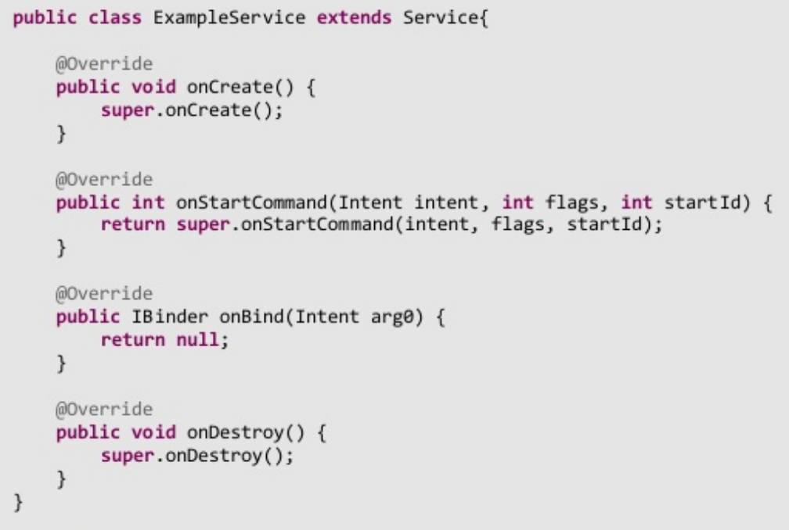
Service

Slide 11
Using Service
Services The Service.onStartCommand() method must return an integer value. This tells the system how the Service will be managed and destroyed.
START_NOT_STICKY: Service is not rebuilt unless there are pending Intent-to-manage.
START_STICKY: Service is always recreated by switching to Service.onStartCommand() as a parameter to a null Intent.
START_REDELIVER_INTENT: Service is always recreated by switching to Service.onStartCommand() the last Intent received.

Slide 12
Intent Service
An IntentService does the following:
It creates a WorkerThread to perform all tasks in series
It creates a queue of Intent to pass the implementation of the IntentService.onHandleIntent() method
It destroys itself when the queue is empty
It provides an implementation of Service.onBind() that returns null by default
It provides a default implementation of Service.onStartCommand() to manage the queue of requests that then have to be sent to IntentService.onHandleIntent() Started Service - IntentService

Slide 13
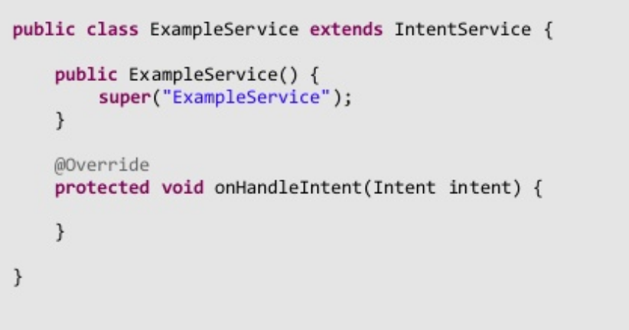
Intent Service

Slide 14
Bound Service
To communicate outside the feed, or manage the operations to another component running in the same process you can create a Bound Service.
A Bound Service is the server part of a client-server interface.
To attach a Service the Service.onBind() method must return a IBinder that provides the communications interface between the Service and the other component.

Slide 15
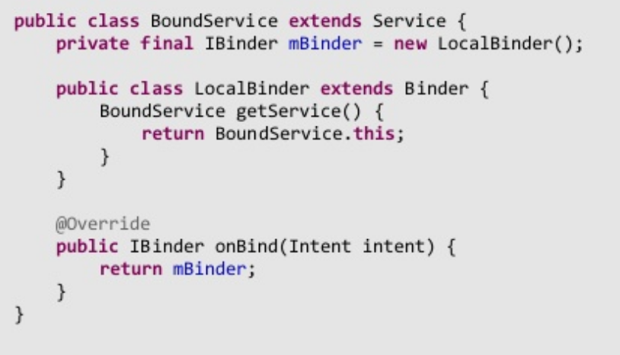
Bound Service

Slide 16
References
https://developer.android.com/guide/components/services

Slide 17
Thanks!
Any questions?
You can find me at bibesh.manandhar@gmail.com

